Slide 1
PIP4004: UNIVERSITY PROJECT Review-1 Presentation Development of a Geolocation-Based Attendance Tracking Mobile Application
Batch Number: CCS-17
Roll Number | Student Name
20211CCS0015 | K. Harshitha
20211CCS0181 | P. Reshma Reddy
20211CCS0155 | Shreya Dhatri Gowda
20211CCS0070 | Saanjh Mohanty
20211CCS0135 | Syeda Shariffa Moosa
Under the Supervision of,
Mr. Tanveer Ahmed
Assistant Professor
School of Computer Science and Engineering
Presidency University
Name of the Program: PIP-4004 Cap Stone Project
Name of the HoD: Dr. Anand Raj S P
Name of the Program Project Coordinator: Dr.Sharmasth Vali
Name of the School Project Coordinators: Dr. Sampath A K / Dr. Abdul Khadar A / Mr. Md Ziaur Rahman

Slide 2
Abstract
The development of a Geolocation-Based Attendance Tracking Mobile Application aims
to enhance the efficiency and accuracy of tracking employee attendance by leveraging GPS technology. This mobile application, designed using Flutter, enables employees to check in and check out based on their real-time geographical location, ensuring that attendance is only marked when employees are at designated work locations . The application provides features such as geofencing to create virtual boundaries around office premises, time-stamping of attendance records, and automated attendance reports for both employees and management. The system offers enhanced transparency, reduces the risk of fraudulent attendance entries, and supports effective workforce management for organizations like GAIL (India) Ltd. The project focuses on building a user-friendly interface, integrating secure data storage, and ensuring scalability for future expansion. Ultimately, the application strives to streamline attendance monitoring while contributing to the overall productivity and operational efficiency of the organization.

Slide 3
Literature survey
Literature survey on the Development of a Geolocation-Based Attendance Tracking Mobile Application explores the integration of geolocation technologies, mobile development frameworks, and attendance management systems. Key themes include:
Geolocation Technology: GPS and RFID systems are commonly used to track user locations for verifying attendance. GPS ensures real-time tracking, while RFID offers proximity-based attendance.
Mobile Application Development: Frameworks like Flutter, React Native, and Kotlin are widely
used for building cross-platform mobile applications, providing an efficient development process and ensuring smooth user interfaces.
Attendance Management: Traditional systems rely on manual check-ins, leading to human errors.
Geolocation-based systems automate attendance, ensuring accuracy and reducing fraudulent activities such as buddy punching.
Backend Technologies: The integration of cloud-based backends, such as Firebase or AWS, allows
secure storage of attendance data and real-time updates. These solutions also ensure scalability and data integrity.
Privacy and Security: Geolocation-based applications raise concerns about privacy. Implementing measures such as user consent for location tracking and data encryption is crucial for ensuring user trust.

Slide 4
Use Cases: Industries like education, healthcare, and corporate organizations have successfully implemented such systems to improve attendance monitoring, optimize resources, and enhance operational efficiency.
This survey identifies a growing trend toward digital, automated attendance systems, demonstrating the potential for geolocation-based solutions to improve accuracy, efficiency, and security in attendance tracking.

Slide 5
Objectives
Real-Time Attendance Tracking
Accuracy and Efficiency
User-Friendly Interface
Location-based Validation
Real-Time Data Synchronization
Privacy and Security
Analytics and Reporting
Scalability

Slide 6
Existing Methods Drawbacks
1. Manual Attendance Systems:
Human Error:
Time-Consuming:
Data Entry Issues:
Fraudulent Activities:
2. Barcode/RFID-based Attendance Systems:
Limited Location Tracking:
Dependence on Physical Devices:
Security Concerns:
3. Geolocation Systems (without robust implementation):
Privacy Issues:
GPS Accuracy:
Geofencing Limitations:
Battery Drain:

Slide 7
Proposed Method
The proposed Geolocation-Based Employee Attendance Tracking App aims to automate
and streamline attendance management across multiple office locations. The system will utilize
geolocation technology to record employees' check-in and check-out times when they enter
or leave a predefined 200-meter office radius. Additionally, it will support manual check
in/out for offsite work with location suggestions based on real-time GPS data. The application
will ensure accurate working hour calculations, data integrity, and real-time
synchronization using Firebase. By eliminating manual attendance tracking, the app will
enhance operational efficiency, reduce errors, and provide a seamless user experience
for both employees and administrators.

Slide 8
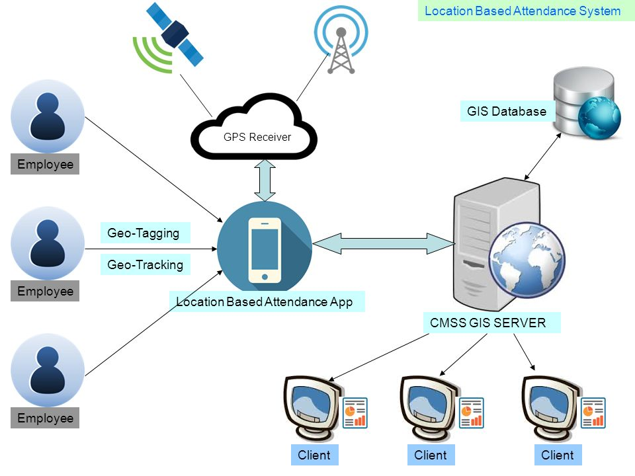
Architecture Diagram

Slide 9
Modules
1. User Authentication Module
2. Attendance Marking Module
3. Geolocation and Geofencing Module
4. Attendance Data Management and Syncing Module
5. Admin Panel/Management Module
6. Privacy and Security Module
7. Integration Module

Slide 10
Technology Components
Technology Stack Components:
Frontend (Mobile App): React Native (for cross-platform),
Flutter.
Backend: Node.js (Express.js), Django (Python)
Database: Firebase Fire-store
Authentication: Firebase Auth.
Geolocation Services: Google Maps API.

Slide 11
Software And Hardware Requirements
Software and Hardware Requirements:
Development Tools
Flutter SDK (Latest stable version) – Download
Dart SDK (Included with Flutter) Android Studio (Recommended for Android development)
Mobile OS Compatibility
Android (Minimum SDK 21, Recommended SDK 33+)
Backend & Database
Firebase Fire-store (Cloud database, real-time sync)
Firebase Authentication (For login, security)
Hardware Requirements
Development Machine
Windows / Linux
Minimum: 8GB RAM, Core i5, SSD
Recommended: 16GB RAM, Core i7, SSD

Slide 12
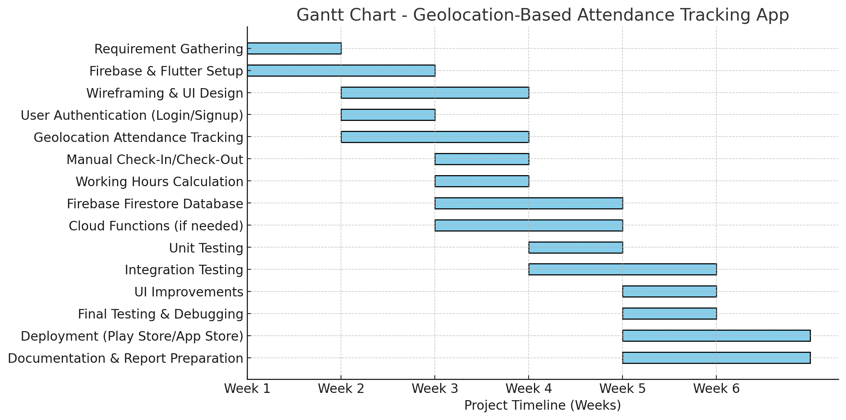
Timeline of the Project (Gantt Chart)

Slide 13
References (IEEE Paper format)
Singh, T. Goel, D. Srivastava and A. Singh, "Location Based Attendance Monitoring System", Int. J. Eng. Appl. Sci. and Technology, vol. 5, no. 1, pp. 517-521, 2020.
A. K. Patel and R. Tiwari, "An Implementation Of Geolocation Based Employee Attendance Monitoring System Using Geotagging", Int. J. Eng. Sci. Res. Technol, April 2017.
O. E. Olufunminiyi, "Towards Reducing Covid-19 Spread: A GeoLocation Based Attendance Monitoring and Navigation System for Institution", Global J. Comput. Sci. Technol.: H Inform. Technol, 2021.
Development and Evaluation of an Attendance Tracking System Using Smartphones with GPS and NFC Te-Wei Chiang,Cheng-Ying Yang,Gwo-Jen Chiou,Frank Yeong-Sung Lin,Yi-Nan Lin,Victor R. L. Shen
GEOLOCATION-BASED EMPLOYEE ATTENDANCE AND TRACKING SYSTEM Prof. Sagar Mane*1, Mr. Atharva Bharambe*2, Mr. Mihir Gawade*3, Mr. Nikhil Gandhi*4, Mr. Suyash Bhanwase*5

Slide 14


